Slide 1
KPK Excise & Taxation system using Shibboleth
FYP-I 2nd Progress Presentation
Group Members
Umar Rizwan (15-6023)
Usman Ashraf (15-6016)
Subhan Ahmad (15-6118)
Supervised by
Mr. Fazle Basit
Evaluators
Dr. Muhammad Nauman
Dr. Usman Habib
1 of 17

Slide 2
KPK Excise & Taxation system using Shibboleth
FYP-I 2nd Progress Presentation
Outline
Why Shibboleth
Other Single Sign-On Systems
Shibboleth Identity Provider Configuration
Shibboleth Service Provider Configuration
SAML Key Descriptor Elements
Signing Key Descriptor Element
Encryption Key Descriptor
SAML Keys and Certificates
Adding DataBase
2 of 17

Slide 3
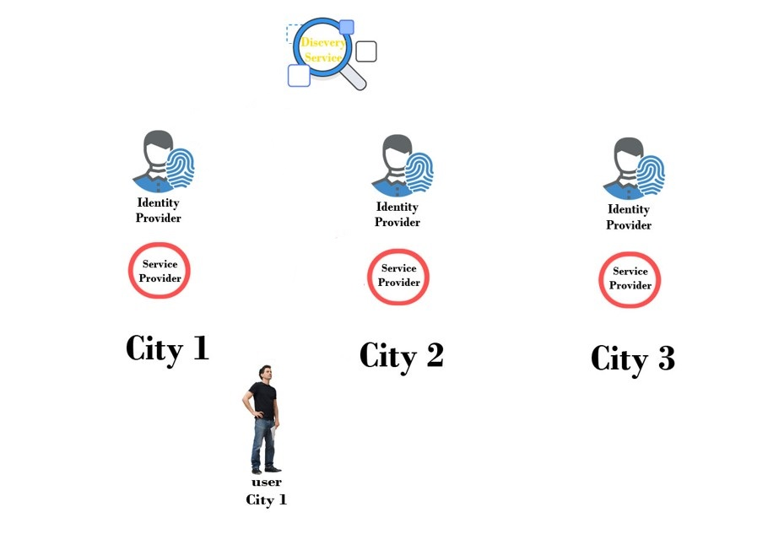
KPK Excise & Taxation system using Shibboleth
FYP-I 2nd Progress Presentation
Model
3
2
4
1
5
3 of 17

Slide 4
KPK Excise & Taxation system using Shibboleth
Why Shibboleth
FYP-I 2nd Progress Presentation
Motivation:
Open source implementation.
Could be plugin to existing enterprise identity management
& authentication systems (CAS, LDAP, SQL).
Has been reviewed & tested for more than 15+ years by organizations and experts
therefore Robust PKI trust based IT security middleware.
Sp must be able to support the decrypting data with both the old and new keys at once, (shibboleth can but not every implementation can).
3
2
4
1
5
4 of 17

Slide 5
KPK Excise & Taxation system using Shibboleth
Why Shibboleth
Other Single Sign-On Systems
FYP-I 2nd Progress Presentation
Different Sign-On currently available:
3
Kerberos (lack of case sensitivity, i.e UsERNAme)
Microsoft passport (Security & privacy)
Athens account (Low Efficiency & effectiveness)
2
4
1
5
5 of 17

Slide 6
Shibboleth IDP Configuration:
KPK Excise & Taxation system using Shibboleth
Why Shibboleth
Other Single Sign-On Systems
Shibboleth Identity Provider Configuration
FYP-I 2nd Progress Presentation
Requirements
Modify access control.xml
Modify idp.xml
Providing SP metadata to Idp
6 of 17

Slide 7

Requirements:
KPK Excise & Taxation system using Shibboleth
Why Shibboleth
Other Single Sign-On Systems
Shibboleth Identity Provider Configuration
FYP-I 2nd Progress Presentation
Server (tomcat, java) must be installed.
Working DNS resolver
Adding user and define role in server (Tomcat-user.xml)
7 of 17

Slide 8
KPK Excise & Taxation system using Shibboleth
Why Shibboleth
Other Single Sign-On Systems
Shibboleth Identity Provider Configuration
FYP-I 2nd Progress Presentation
Modify access control.xml
Add your network and no. of bits in CIDR notation.
Modify idp.xml
For deploying Idp on tomcat
8 of 17

Slide 9

Providing SP metadata to IDP:
Why Shibboleth
Other Single Sign-On Systems
Shibboleth Identity Provider Configuration
KPK Excise & Taxation system using Shibboleth
FYP-I 2nd Progress Presentation
By adding following lines Idp metadata directory
9 of 17

Slide 10
Shibboleth SP Configuration
KPK Excise & Taxation system using Shibboleth
Why Shibboleth
Other Single Sign-On Systems
Shibboleth Identity Provider Configuration
Shibboleth Service Provider Configuration
FYP-I 2nd Progress Presentation
Open the SP configuration file (shibboleth.xml)
Change the following tags in that configuration file:
<ApplicationDefaults> tag, change the entityID
<Sessions> tag, change handlerSSL to true and
cookieProps to https
<SSO> tag change the entityID value to the same
value as your IdP’s entityID
<Handler> tag, add your IP address to the acl value.
It takes a list of space-delimited IP addresses or
networks in CIDR notation. eg. 10.0.0.0/24
10 of 17

Slide 11


ADD Metadata
KPK Excise & Taxation system using Shibboleth
Why Shibboleth
Other Single Sign-On Systems
Shibboleth Identity Provider Configuration
Shibboleth Service Provider Configuration
FYP-I 2nd Progress Presentation
Add the <MetadataProvider> block as follows
Write SSL key/certificate pair
11 of 17

Slide 12
SAML Key Descriptor Elements
KPK Excise & Taxation system using Shibboleth
Why Shibboleth
Other Single Sign-On Systems
Shibboleth Identity Provider Configuration
Shibboleth Service Provider Configuration
SAML Key Descriptor Elements
FYP-I 2nd Progress Presentation
Signing key descriptor:
It enables message level signing (XML signature) or back-channel TLS
authentication or both.
Encryption key descriptor:
It enables message level encryption (XML encryption).
12 of 17

Slide 13
SAML Key and certificate
Why Shibboleth
Other Single Sign-On Systems
Shibboleth Identity Provider Configuration
Shibboleth Service Provider Configuration
SAML Key Descriptor Elements
SAML Keys and Certificates
KPK Excise & Taxation system using Shibboleth
FYP-I 2nd Progress Presentation
Signing key and certificate:
Provides authencity and integrity at message level.
TLS key and certificate:
Key pair used for back-channel TLS authentication, which
provides authencity at transport level.
Encryption key and certificate:
Used for XML encryption, public key bounds to encryption certificate and private key is held by party that decrypts XML message.
13 of 17

Slide 14
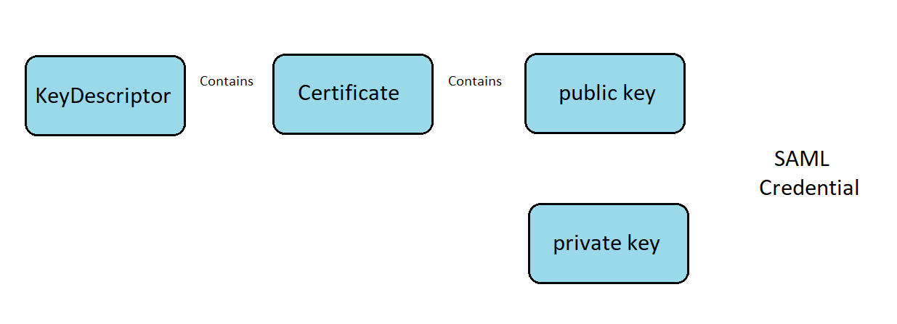
KPK Excise & Taxation system using Shibboleth
FYP-I 2nd Progress Presentation
14 of 17

Slide 15
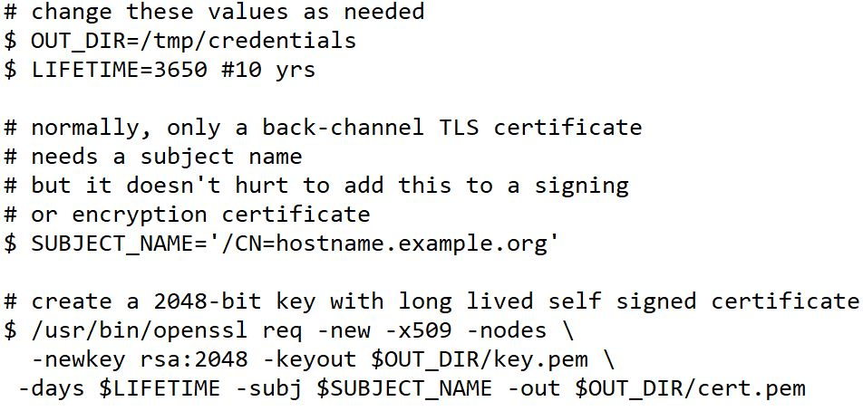
Create a private key and certificate
KPK Excise & Taxation system using Shibboleth
FYP-I 2nd Progress Presentation
15 of 17

Slide 16
Adding Database (using JPA)
Why Shibboleth
Other Single Sign-On Systems
Shibboleth Identity Provider Configuration
Shibboleth Service Provider Configuration
SAML Key Descriptor Elements
SAML Keys and Certificates
Adding DataBase
KPK Excise & Taxation system using Shibboleth
FYP-I 2nd Progress Presentation
In attribute-resolver.xml add connector using <resolver : Dataconnector>
Setup mysql database and tables to store values.
Edit idp.properties to use JPA storage service.
16 of 17

Slide 17
KPK Excise & Taxation system using Shibboleth
FYP-I 2nd Progress Presentation
Any Questions
Thank You!
17 of 17

